Slide 1

Internal Project Abstract Review
Effect of Thermo-Mechanical Treatment in Austenitic Condition on Flow Behaviour of Reduced Activation Ferritic-Martensitic Steel
NAME OF THE PROJECT GUIDE
Mr.G.KULADEEP
Names of the Project Batch students
S. Pavan kalyan Reddy 19121A03D2
P. Siva Teja 20125A0333
K. Muni Sai Kumar Reddy 20125A0327
D. Reddy Sekhar 20125A0324
SK. Mohammad Waseem 19121A03C9
Date : 08-02-2023

Slide 2
Title
Effect of Thermo-Mechanical Treatment in Austenitic Condition on Flow behaviour of Reduced Activation Ferritic-Martensitic Steel

Slide 3
Introduction :
Reduced Activation Ferritic-Martensitic (RAFM) :
Reduced activation ferritic-martensitic (RAFM) steels have gained attention as potential structural material for plasma facing blanket module in nuclear fusion reactors.
These steels are specially developed in order to Reduce the Radioactive Wastage after its Service in Fusion Reactor application.
the RAFM steel is used in normalized and tempered condition,which consists of tempered martensitic microstructure.
The tempered martensitic steel derives its high temperature strength from the complex microstructure consisting of high dislocation density; sub-grain boundaries decorated with chromium rich M23C6 carbides and MX type carbides/carbonitrides in the intragranular region.

Slide 4
Thermo-Mechanical Treatment :
The principle behind the TMT processing is that the plastic deformation of metastable austenite leads to creation of defects in the steel.
These defects are retained during quenching which is subsequent to TMT and these faults acts as nucleating sites for formation of precipitates.
The basic objective of the TMT is to improve the mechanical properties of the material without losing or even sometimes improvement in the ductility.

Slide 5
Methodology
(
Literature Review
Selection and Ordering of RAFM Steel components
Fabrication of RAFM Steel
Testing
Analyzing and Flow Behaviour

Slide 6
Literature Review :
International thermoelectric reactor (ITER)
Material requirements for fusion reactors
Development of Reduced activation ferritic martensitic steel for nuclear reactors
(

Slide 7
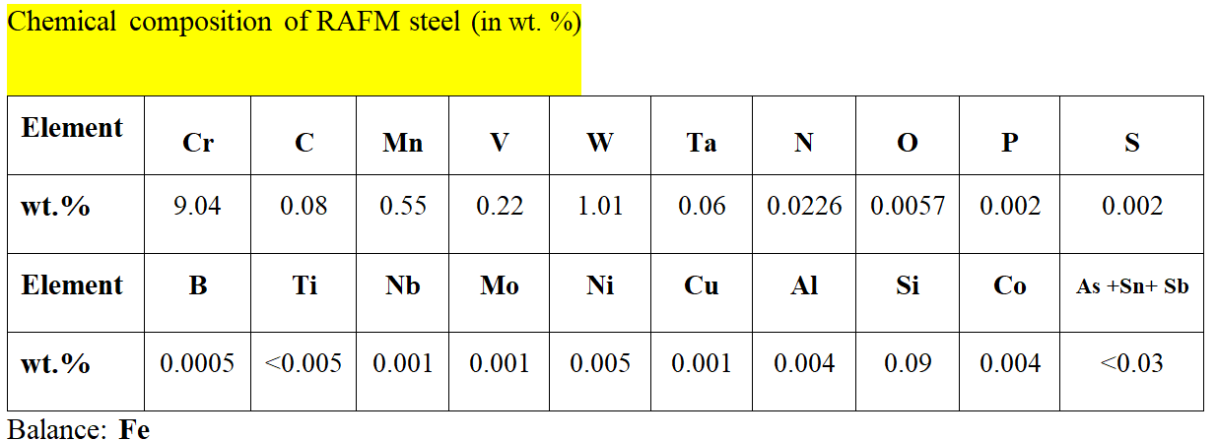
Theoretical Analysis
(

Slide 8
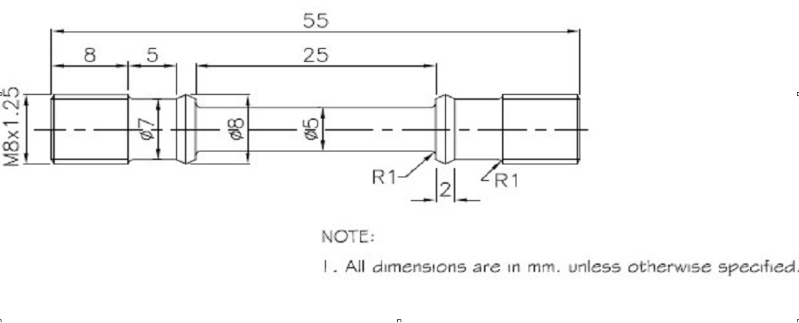
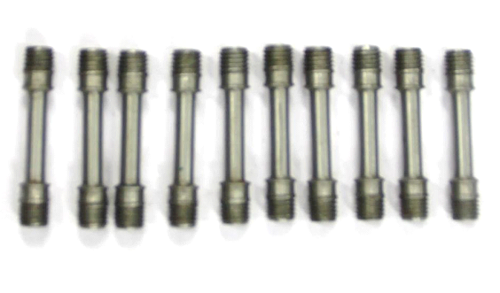
Schematic of standard tensile test
specimen (as per ASTM E8M)

Slide 9
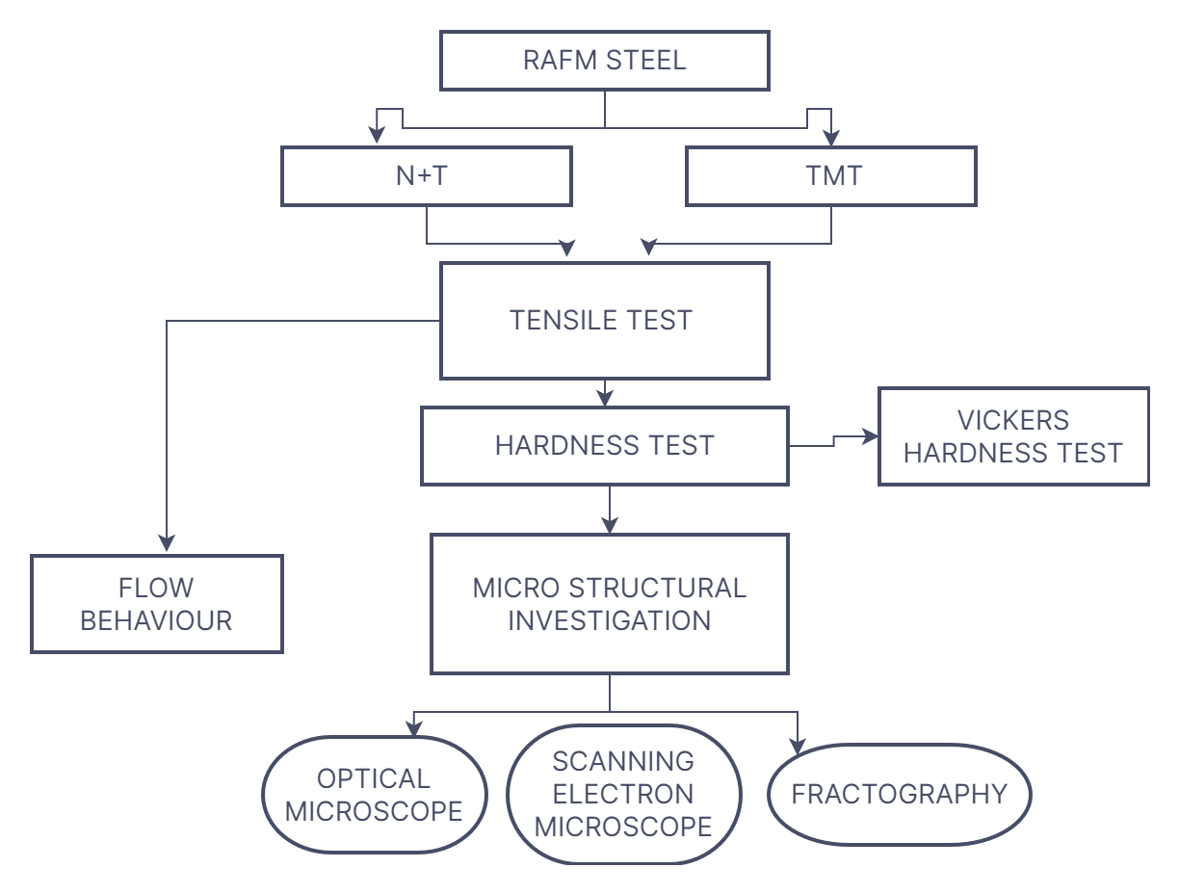
Problem Formulation :

Slide 10
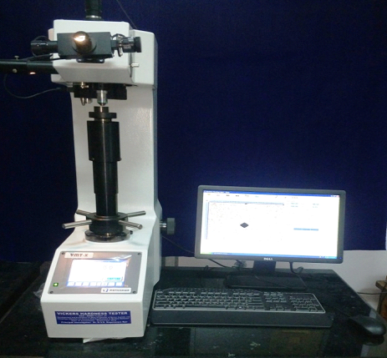
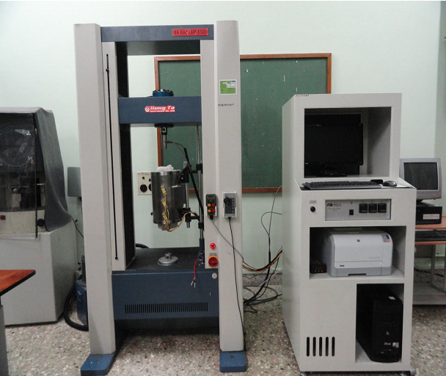
Vickers Hardness Tester
Tensile Test setup

Slide 11
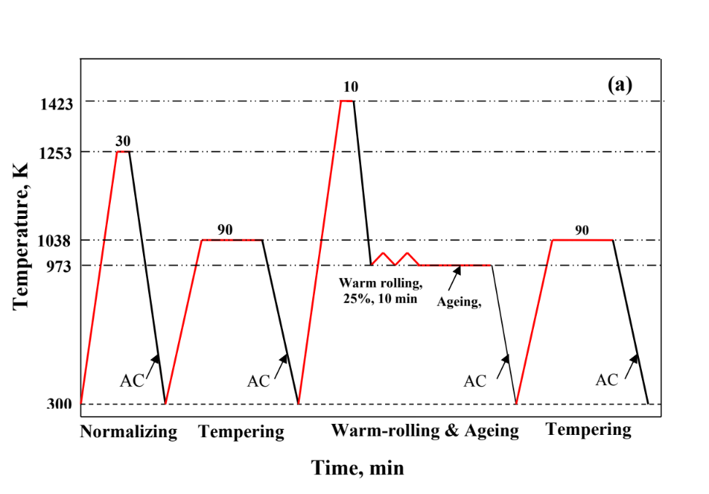
Experimental Investigations
Normalizing and tempering followed by thermomechanical treatment cycle used for RAFM steel in austenitic phase field

Slide 12
Microstructural investigation
Microstructural studies of RAFM steel were carried out by using optical and electron microscopy.
Microstructures were recorded in N+T and TMT conditions of steel in prior to test condition and post-tensile and post-creep test conditions.

Slide 13
Optical microscopy (OM)
Optical microstructures of RAFM steel in N+T and TMT conditions were obtained by using Leica metallurgical microscope equipped with image analysis software
The samples were polished successively on 400, 800, 1200, and 2000 grit silicon carbide emery papers.
Magnification images along with EDS analysis of the matrix and the precipitates, wherever required, were obtained.
These high magnification images are well utilized in quantifying the precipitates (before and after testing) in bothconditions of the steel.

Slide 14
Tensile tests
Tensile tests were carried out on RAFM steel in N+T and TMT25 conditions using Hung-Ta tensile testing machine (model: HT-2402, capacity: 10 ton) in the temperature range of 300 - 923 K
The tensile testing machine is equipped with a 3-zone resistance heating furnace and digital data acquisition system.

Slide 15
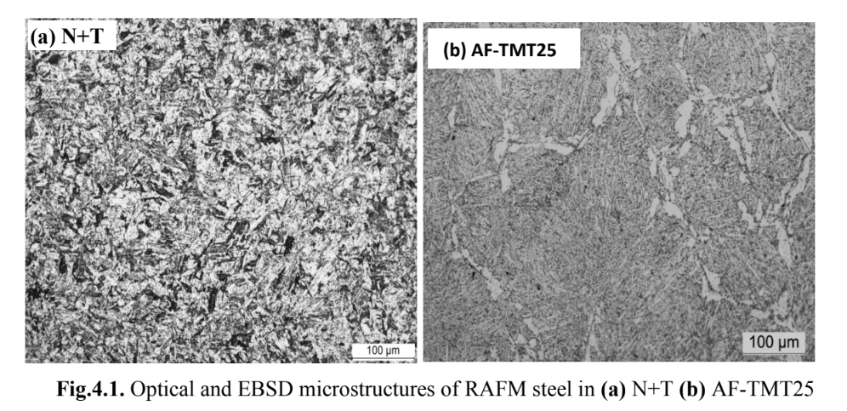
Experimental Results
Microstructure:
1. Optical and electron back scattered diffraction (EBSD) microstructures of RAFM steel in N+T, AF-TMT25 conditions:

Slide 16
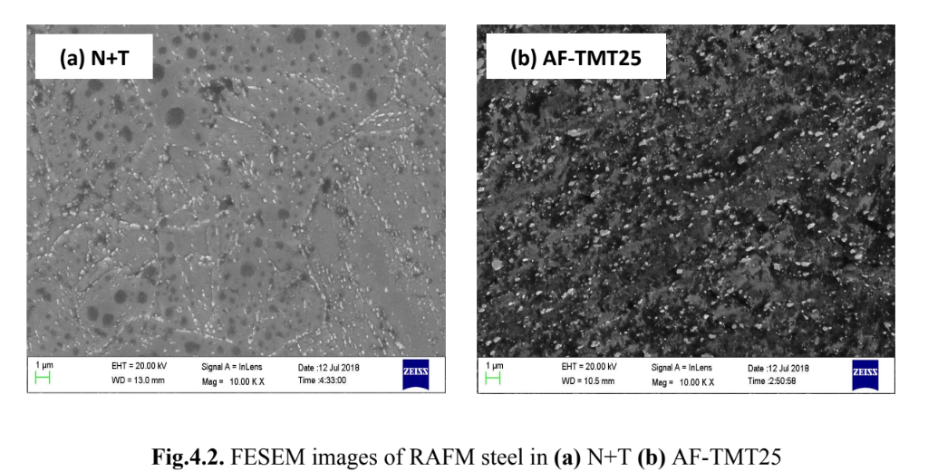
Scanning Electron Microscope (SEM)

Slide 17
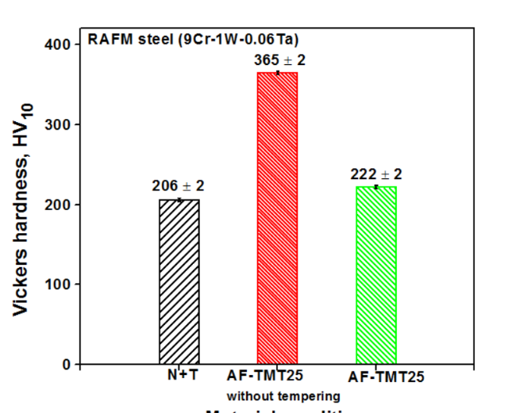
HARDNESS BEHAVIOUR
Effect of TMT in ferritic phase field on hardness

Slide 18
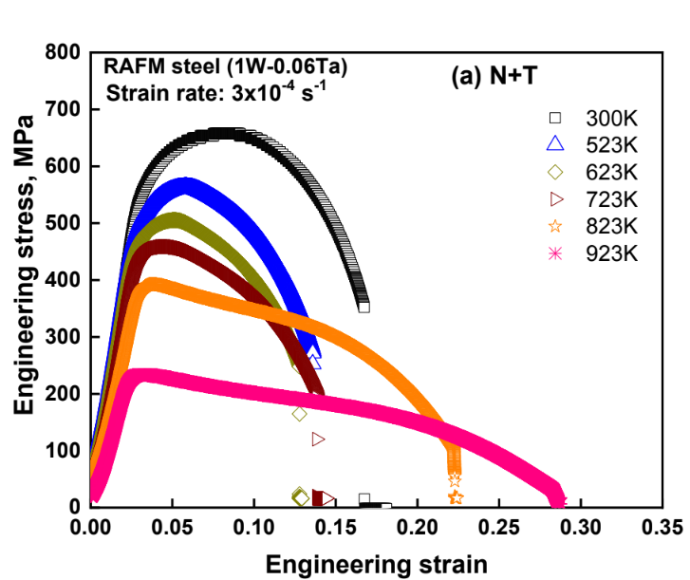
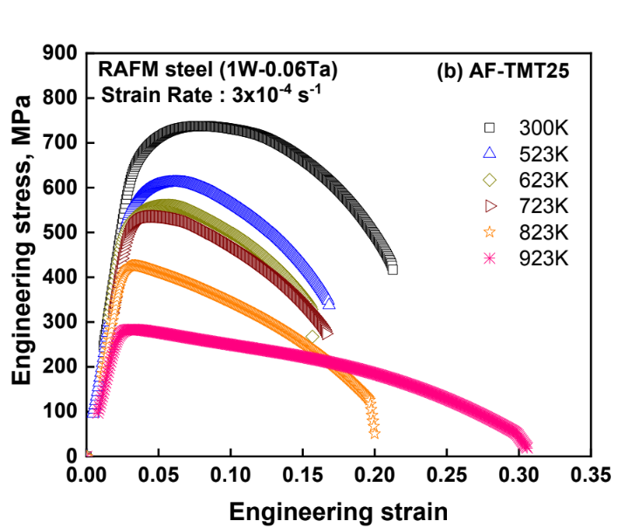
TENSILE BEHAVIOUR

Slide 19
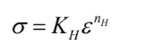
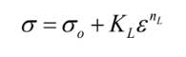
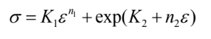
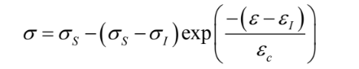
Constitutive flow behaviour:
a) Constitutive equation proposed by Hollomon
b) Constitutive equation proposed by Ludwik
c) Constitutive equation proposed by Ludwigson
d) Constitutive equation proposed by Voce

Slide 20
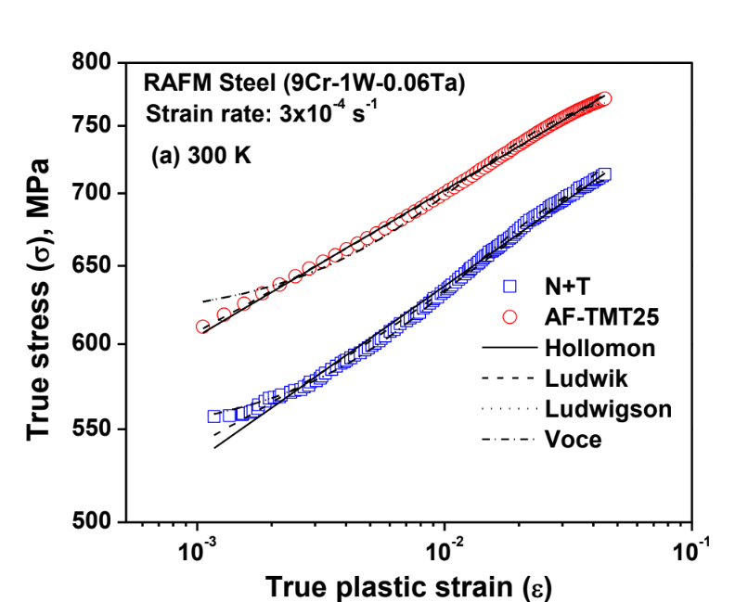
Constitutive flow behaviour:

Slide 21
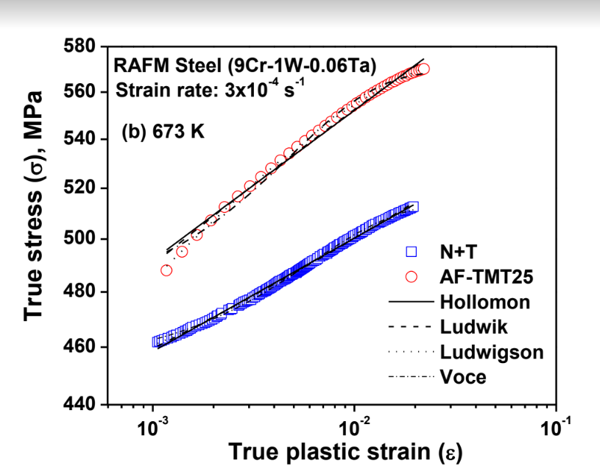
Constitutive flow behaviour:

Slide 22
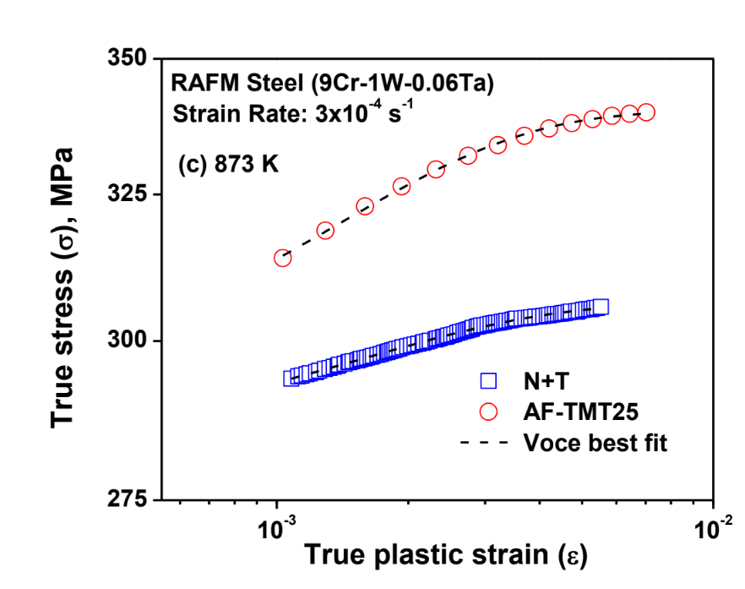
Constitutive flow behaviour:

Slide 23
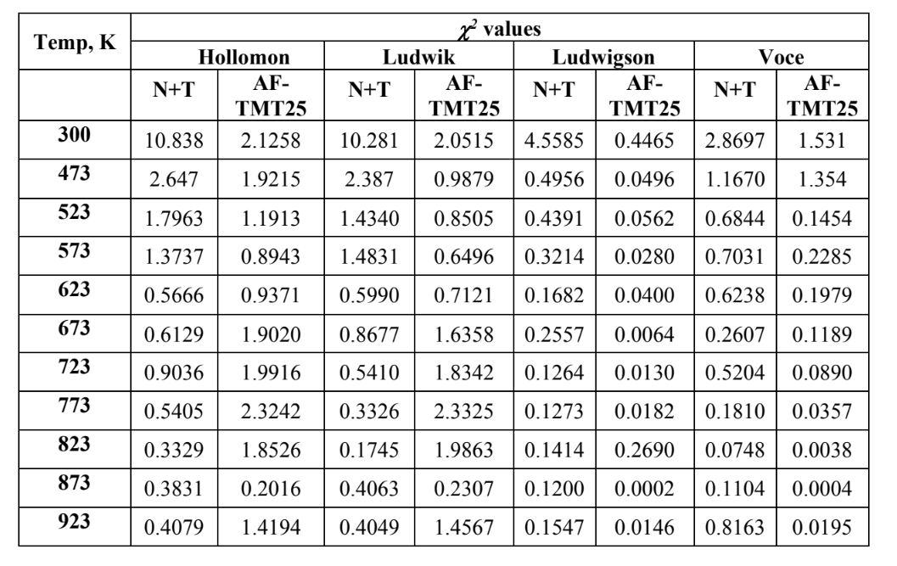

Slide 24
CONCLUSIONS
TMT of the steel refined the microstructure of the tempered martensite having finer lath
size with substantial fine precipitates.
• TMT of the steel increased the hardness and tensile strength coupled with increase in
ductility and work-hardening rate.
• The tensile flow behaviour of the RAFM steel in all three conditions was adequately
described by Voce’s equation.
• TMT enhanced the tensile strength properties of RAFM steel without loss of ductility
and is attributed to the refinement in microstructural features (lath width, precipitate size
and distribution) of RAFM steel upon TMT.
• The steel in AF-TMT25 condition exhibited higher YS and UTS than the steel in the
remaining two conditions. However, the YS and UTS of steel in FF-TMT25 condition
are marginally higher than the steel in N+T condition.

Slide 25
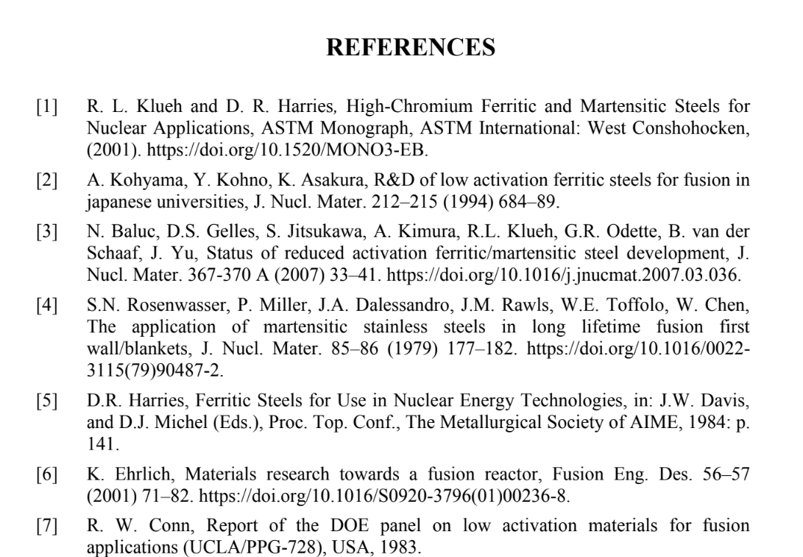

Slide 26
THANK YOU

